Slide 1
MET CS 555 Term Project: House Sales Price Determining Factor in King County, USA
Hao Wu
11/29/2021

Slide 2
Research Senario
The price of a house is often an important part of our society and economy, and the price of a house is usually affected by the size of the house, the number of rooms, and the area where the house is located. This data set includes the housing sales data of the king country from 2014 to 2015, as well as the specific parameters of the houses.
Link: https://www.kaggle.com/harlfoxem/housesalesprediction

Slide 3
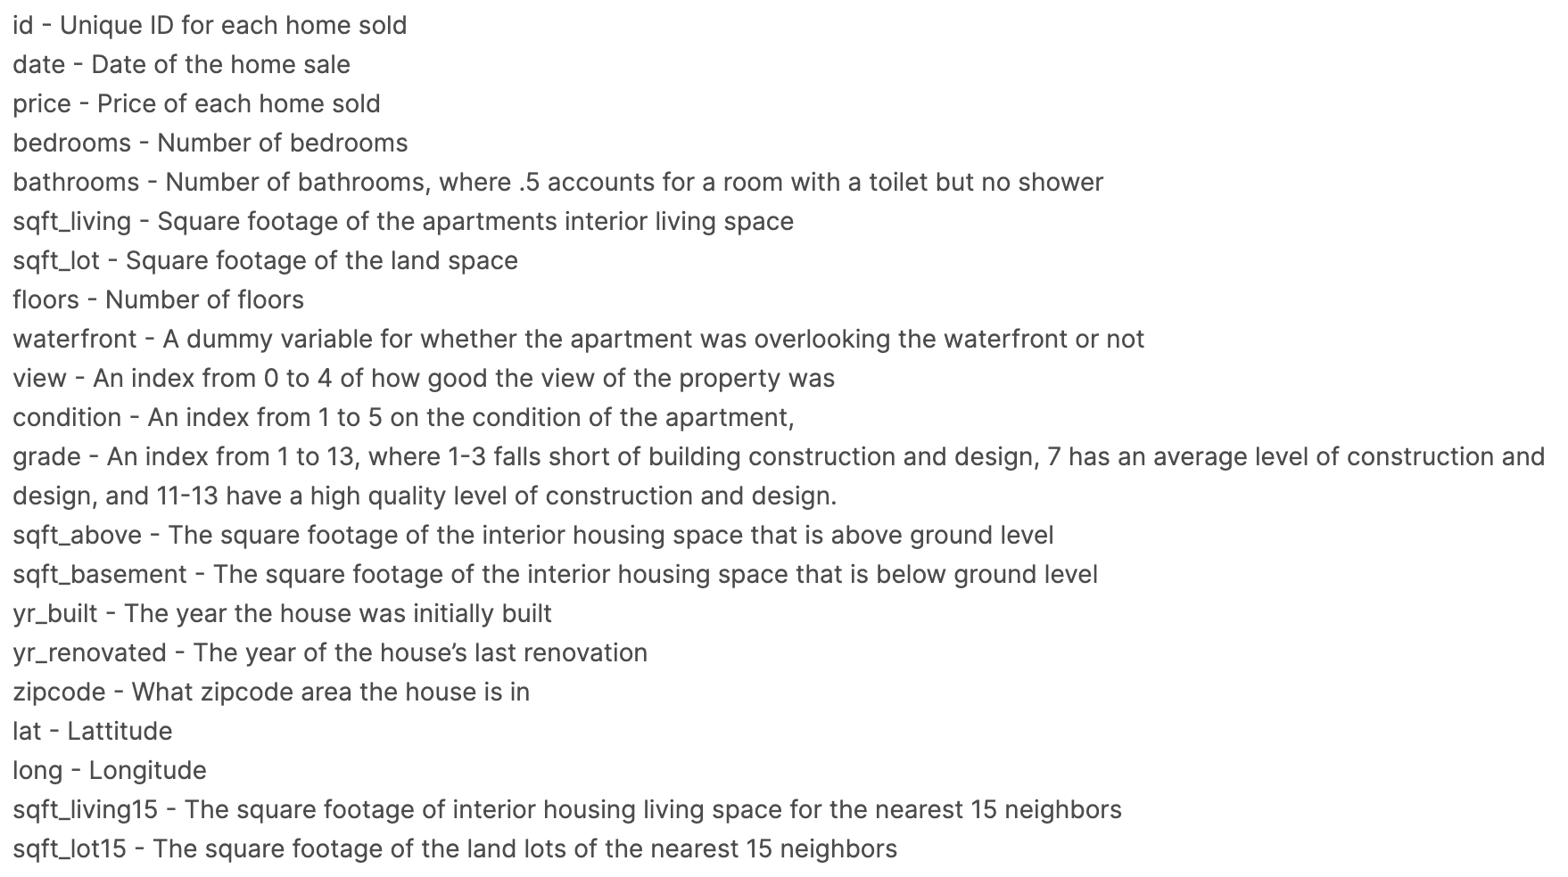
Description of data

Slide 4
Goal
Determinant factor
Control variables(location and sale data)

Slide 5
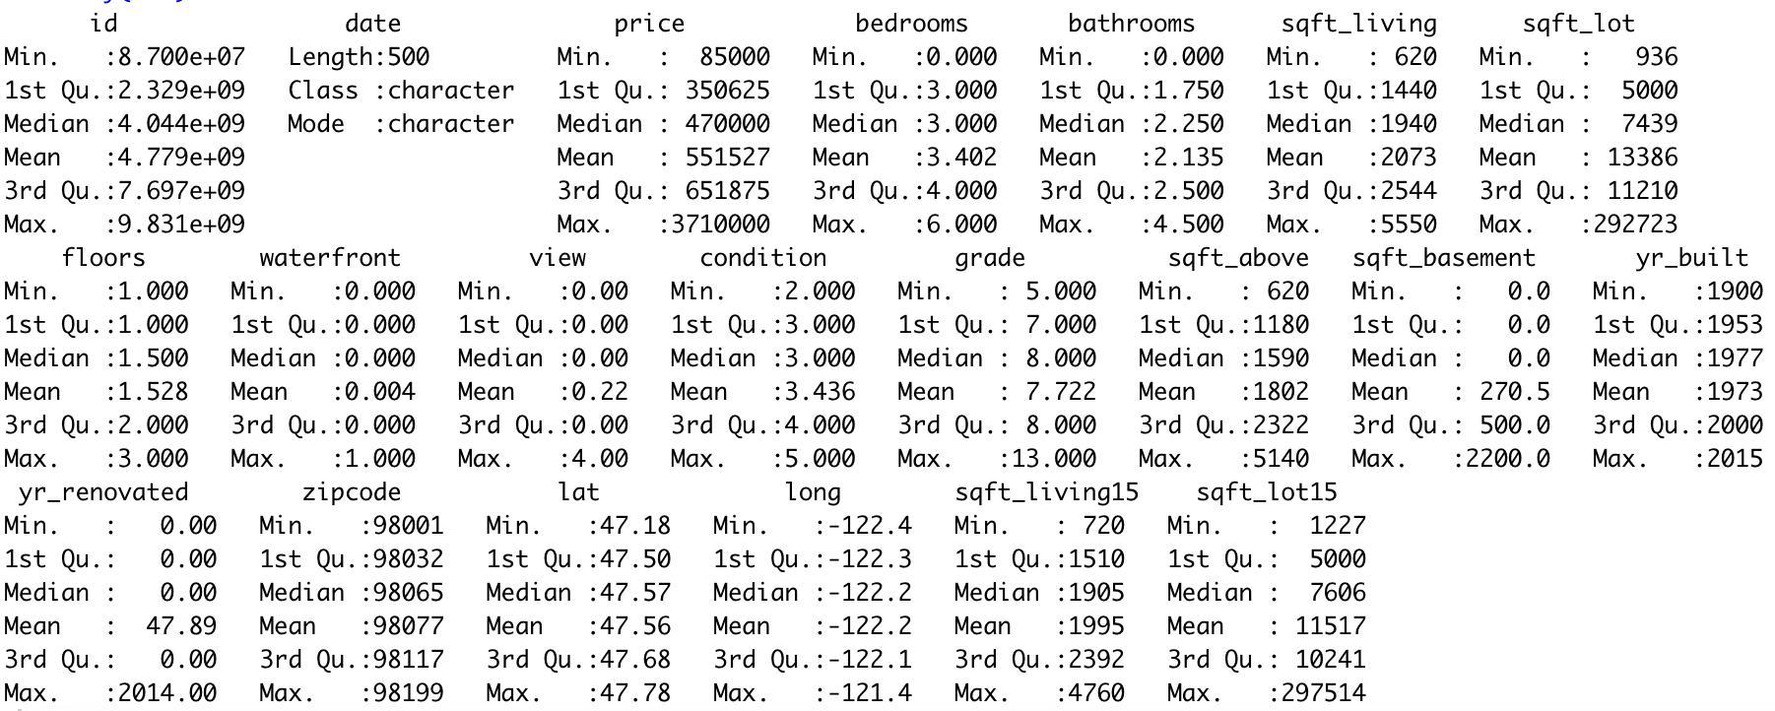
Variables

Slide 6
Data preprocessing
Is there have any variables we do not need?
Why we delete those variables?

Slide 7
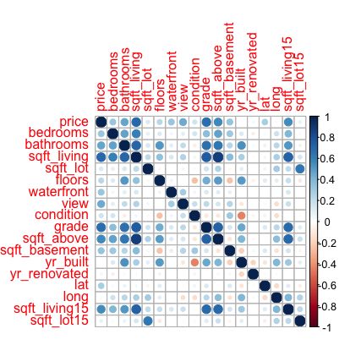
Correlation
Bathrooms
Sqft_living
Grade
Sqft_living15

Slide 8
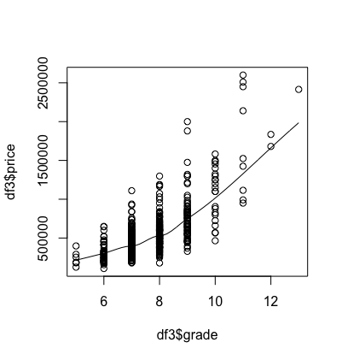
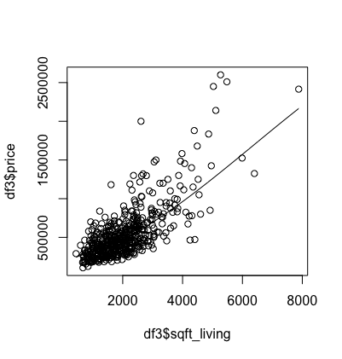
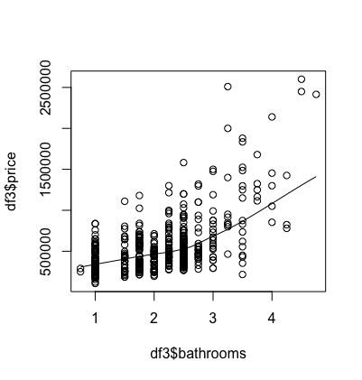
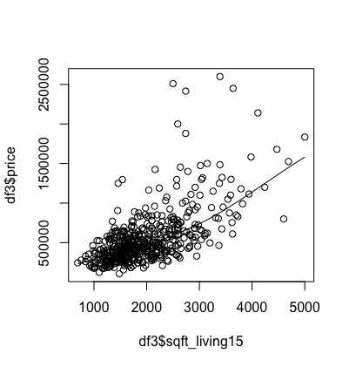
Scatterplot for selected variables

Slide 9
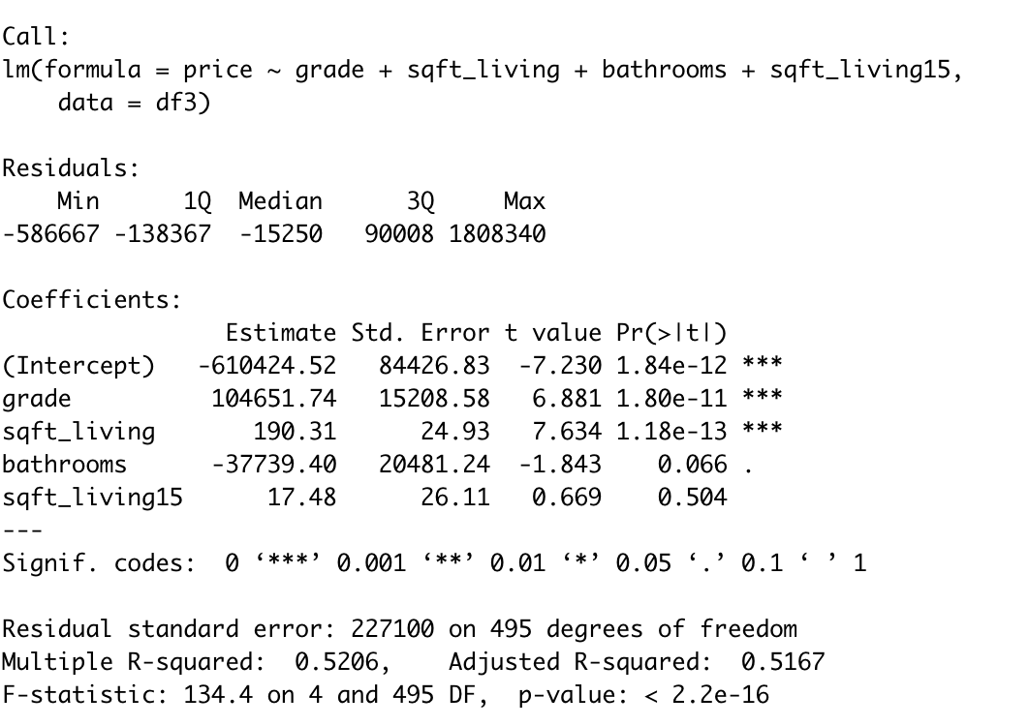
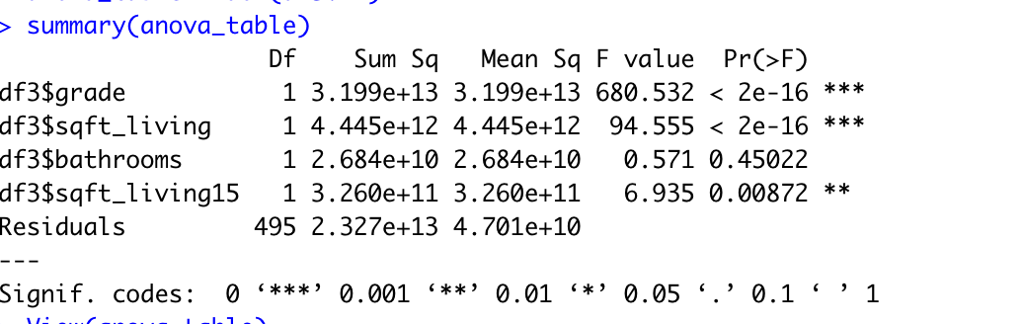
Linear regression

Slide 10
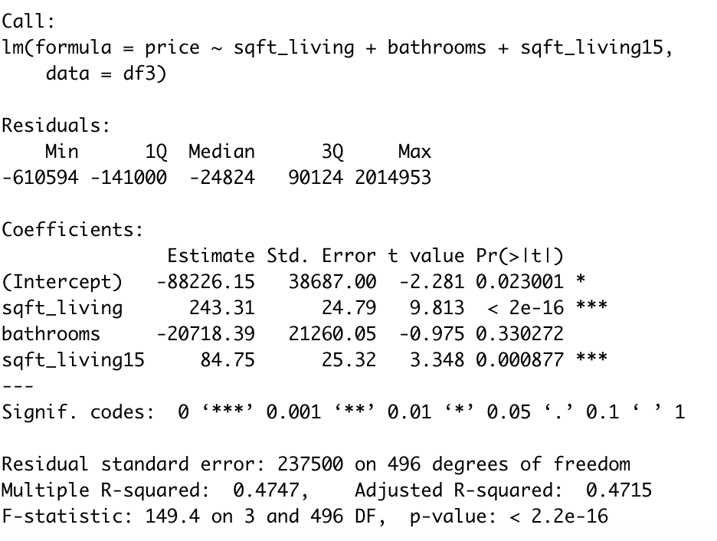
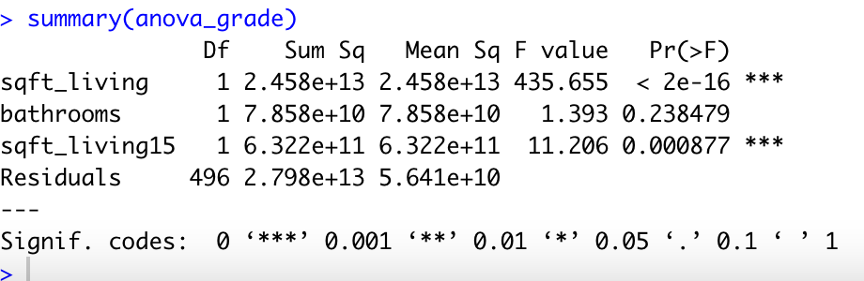
Grade

Slide 11
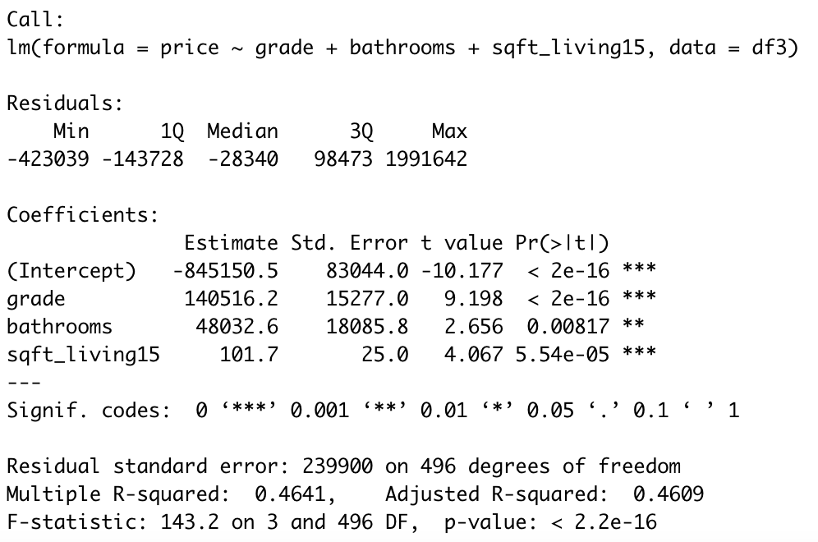
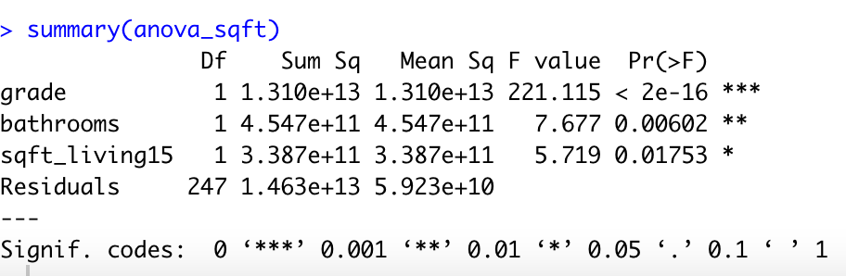
Sqft_living

Slide 12
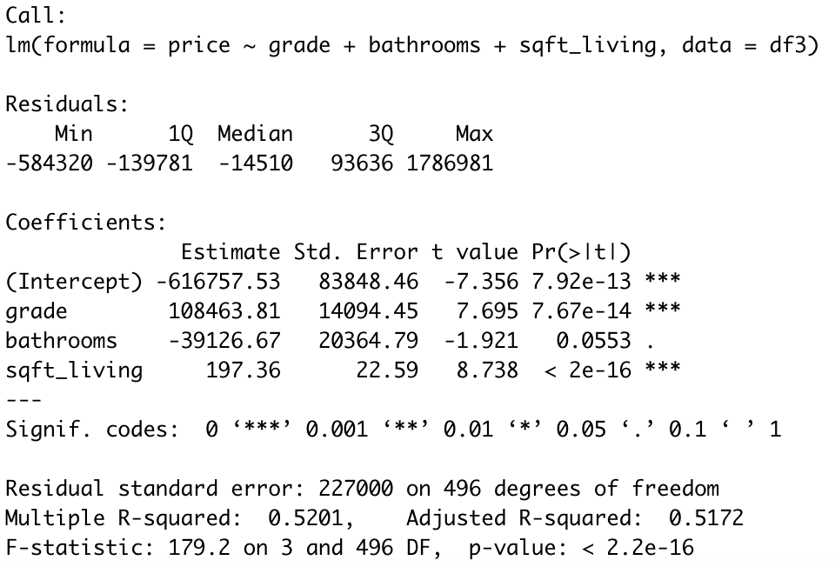
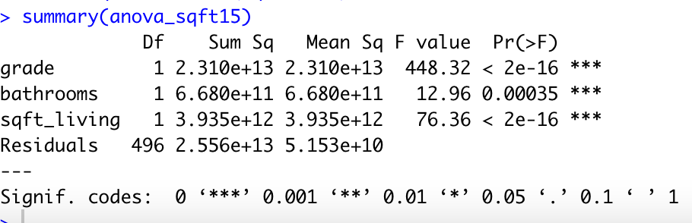
Sqft_living15

Slide 13
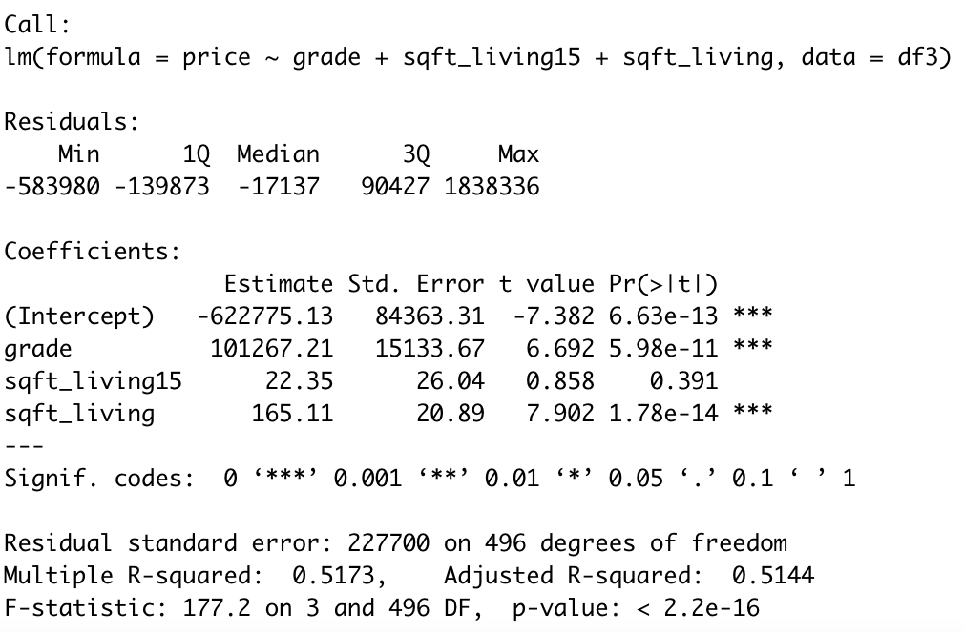
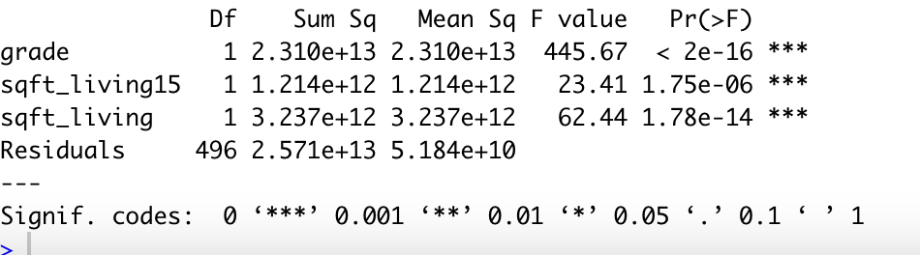
Bathroom

Slide 14
Conclusion
Sqft_living variable is determining factor of house price

Slide 15
Question

